Slide 1
TIRK
Ghana prosjekter

Slide 2
Oversikt (under utarbeidelse)
År | Prosjekt | Støtte [NOK]
2015 | Vannbrønner | 115 120
2015 | Solceller skole(3) og noen hus (7) | 26 000
2016
2017
2018 | ??? | 14 560
2019
2020 | Solceller fødestue Fumbesi (4) | 11 428
2021
2022 | Lekeplass | 13 068
2023 | Solceller barneskole | 11 500
2024 | Skolesekker | 12 000
2025 | Datautstyr/lærebøker
2026

Slide 3
Prosjekt
Ifølge TIRKs webside:
"Siden 2006 har Trondheim International Rotary Club jobbet med et hjelpe-prosjekt rettet mot landsbyen Weisi i Ghana.
Formålet er å bidra til bedret helse for landsbyens innbyggere gjennom målrettede tiltak, f.eks.
  bygging av vannbrønner.
  lys til helse og skole
  støtte til lekeplass
TIRK har vurdert alternative prosjekter, men uttrykt ønske om å bruke egne penger på dette konkrete Ghana-prosjektet.

Slide 4


Justina Amidu har laget postere:
Vannbrønner 2015

Slide 5

Solceller 2020

Slide 6


Slide 7
Prosjekt - lekeplass
The Polo Playground Project to be Constructed at the St. Thomas Aquinas Preparatory School, in the Upper East Region of GHANA
My name is Dr. Christiana Akpilima-Atibil (PhD) and I come from (and currently reside in) the Upper East Region of Ghana, one of the poorest regions in the country. My area of expertise is Philanthropic Studies. I am currently retired from public service, but volunteering in the community.
The Polo Playground Project is an idea that came to me after the untimely death of my oldest son, Charles Atibil. He was 36 years old and a beloved teacher in one of the secondary schools in the region. He loved his students, and loved children in general. In order to honor his memory, and to heal from the painful loss, I decided to start a small organization called the Charles Atibil Memorial Project (CHAMP) to carry out projects that make children’s lives better. The playground project is the largest and most important project that we have undertaken.
We chose to construct the playground at the St. Thomas Aquinas Preparatory School because that school is a not-for-profit institution that provides quality (and subsidized) education to the children in the village. With many children in the village coming from very poor families, St. Thomas Aquinas provides scholarships to the very needy. Unlike the dilapidated and poorly managed public schools around, St. Thomas Aquinas has a functioning management, dedicated staff and eager pupils ready to learn. We determined that our contribution of a safe and durable playground equipment to the school will go a long way in enhancing the children’s education and their overall development. Besides, the equipment will be well-cared for by the management and will last for a long time to serve hundreds of pupils over time.

Slide 8
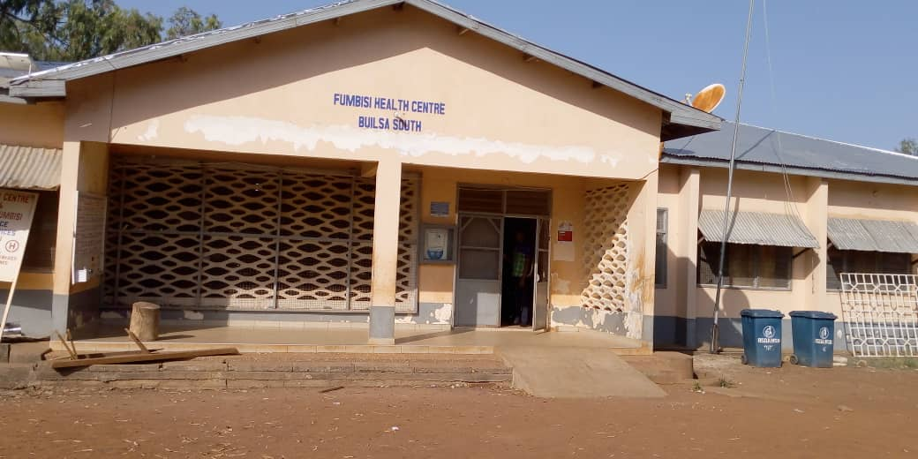
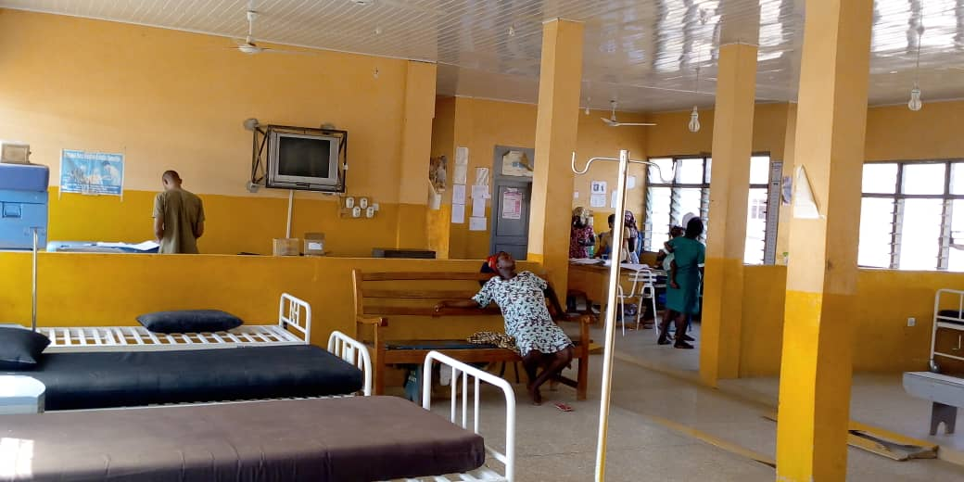
2020 Solceller fødestue Fumbesi

Slide 9
Prosjekt(er) - lekeplass
The Polo Playground Project to be Constructed at the St. Thomas Aquinas Preparatory School, in the Upper East Region of GHANA
I have already contacted the manufacturer of the playground equipment and hope to be able to place our order by the 25th of May to lock in the current prices as prices keep going up every week. The equipment is made with fiberglass, rather than ordinary plastic which tends to crack easily. Fiberglass is safer and more durable but also expensive. Hence our need for assistance.
The playground equipment that we plan to install will cost 30, 000 GHS (minus transportation and installation costs). I have been able to raise a little over 20,000 GHS which I plan to deposit to place the order and to start the manufacturing process. The rest of the amount will be paid upon completion and installation. If I place the order this month, completion and installation will take place in July, 2022.
Your assistance will be very much appreciated. All major donors will have their names inscribed on a plaque to be displayed at the playground. All donations will be accounted for in a transparent manner.
Thank You.
Christiana Akpilima-Atibil (PhD)
Charles Atibil Memorial Project (CHAMP)
Founder and Project Coordinator

Slide 10
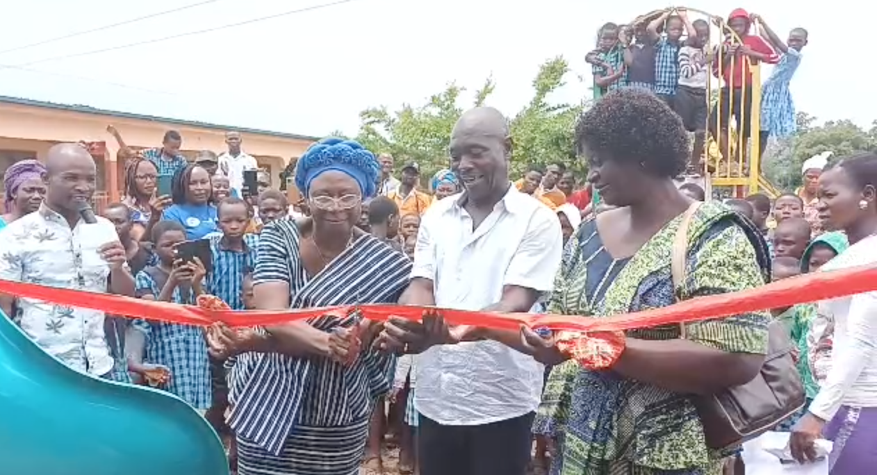
2022 Lekeplass

Slide 11
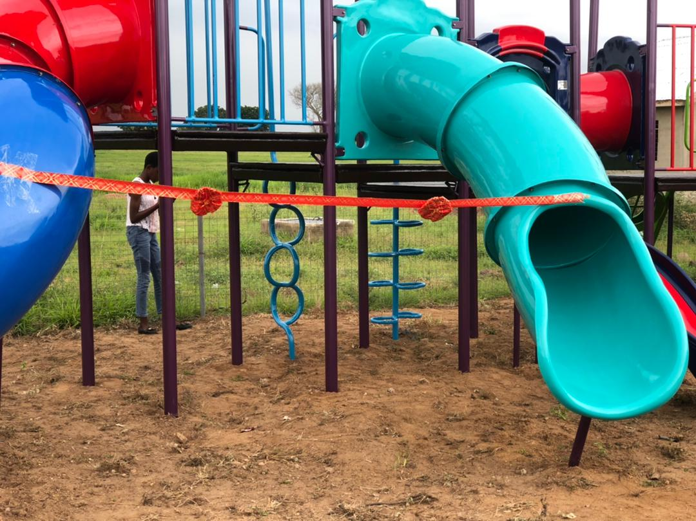
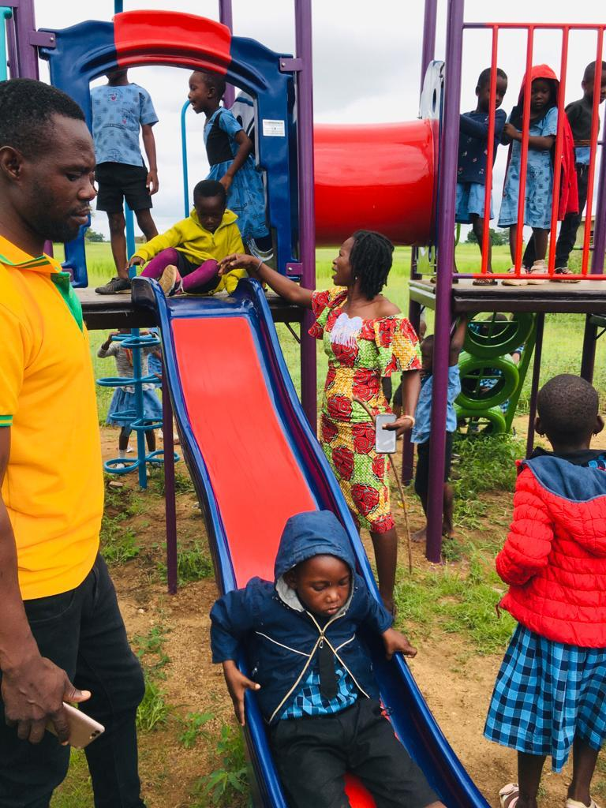

Slide 12
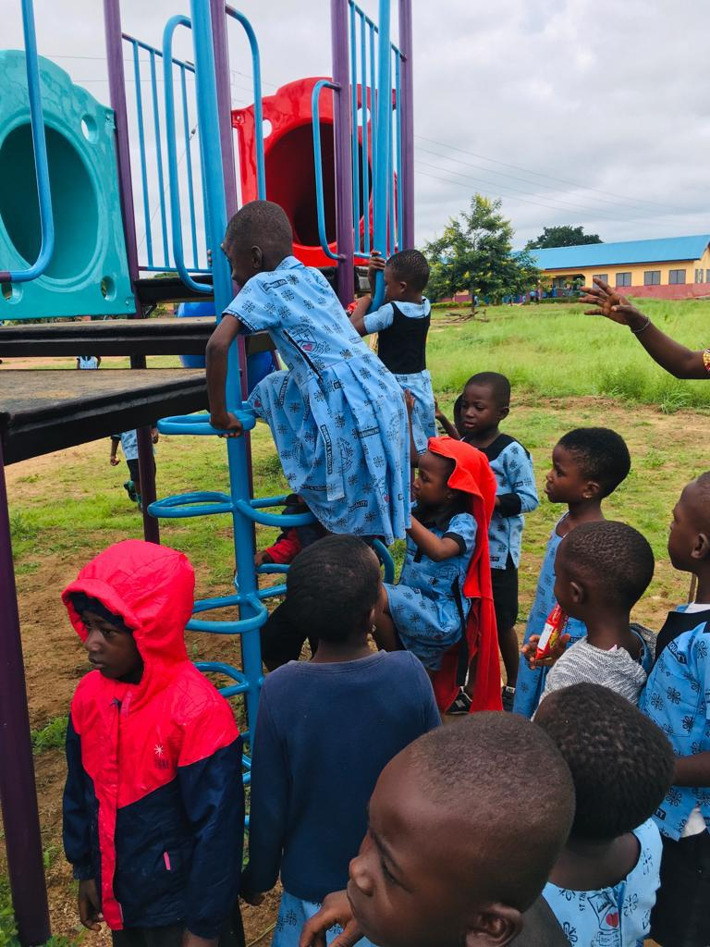
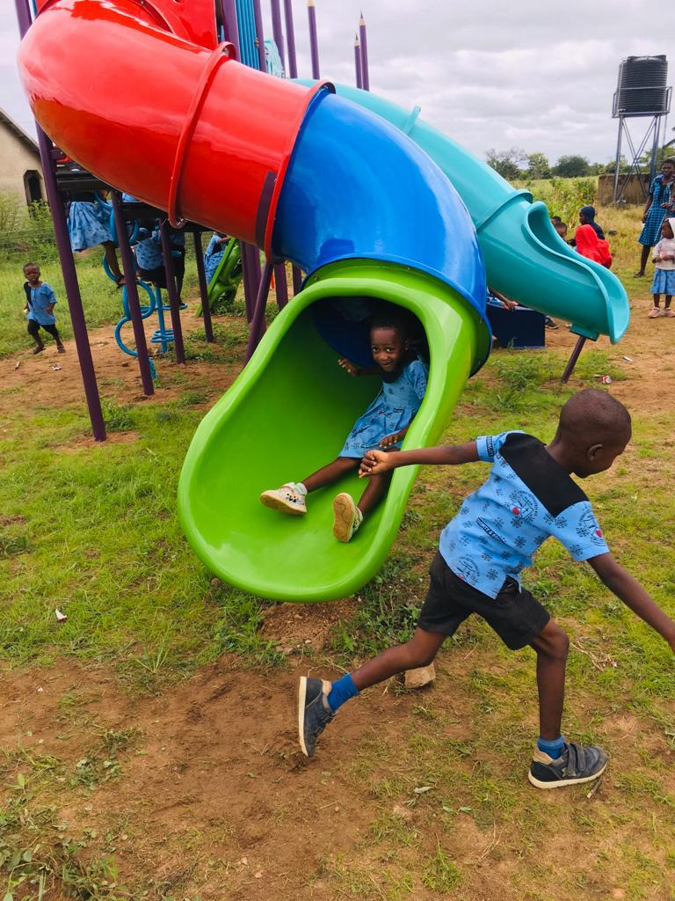
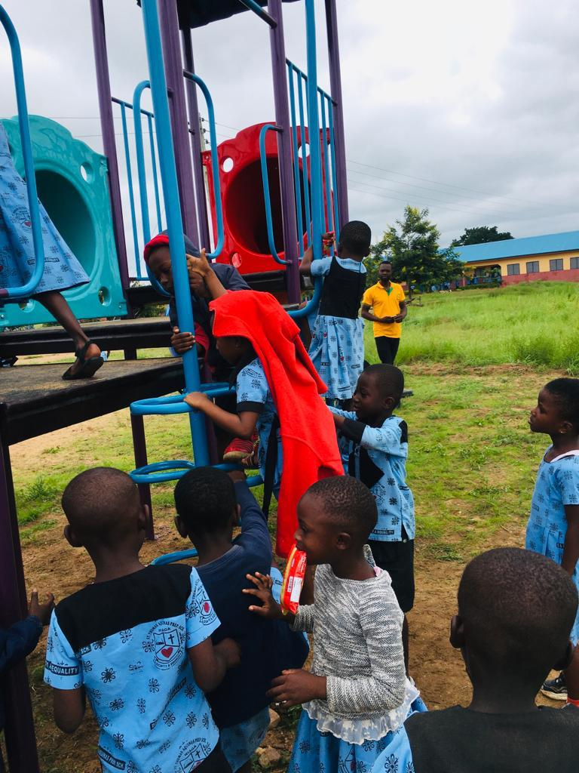

Slide 13
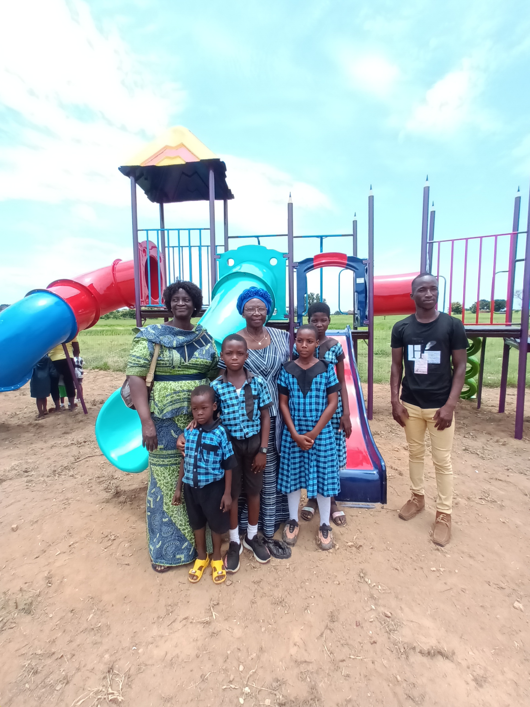
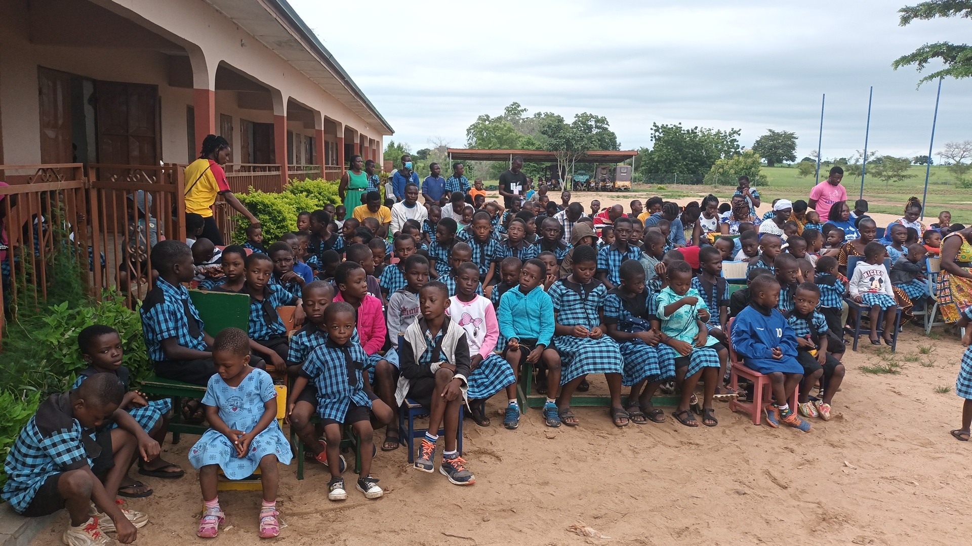

Slide 14

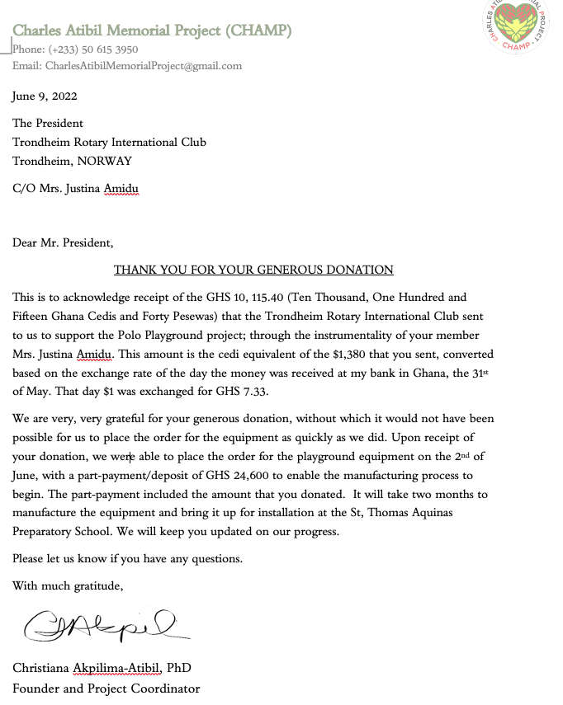

Slide 15
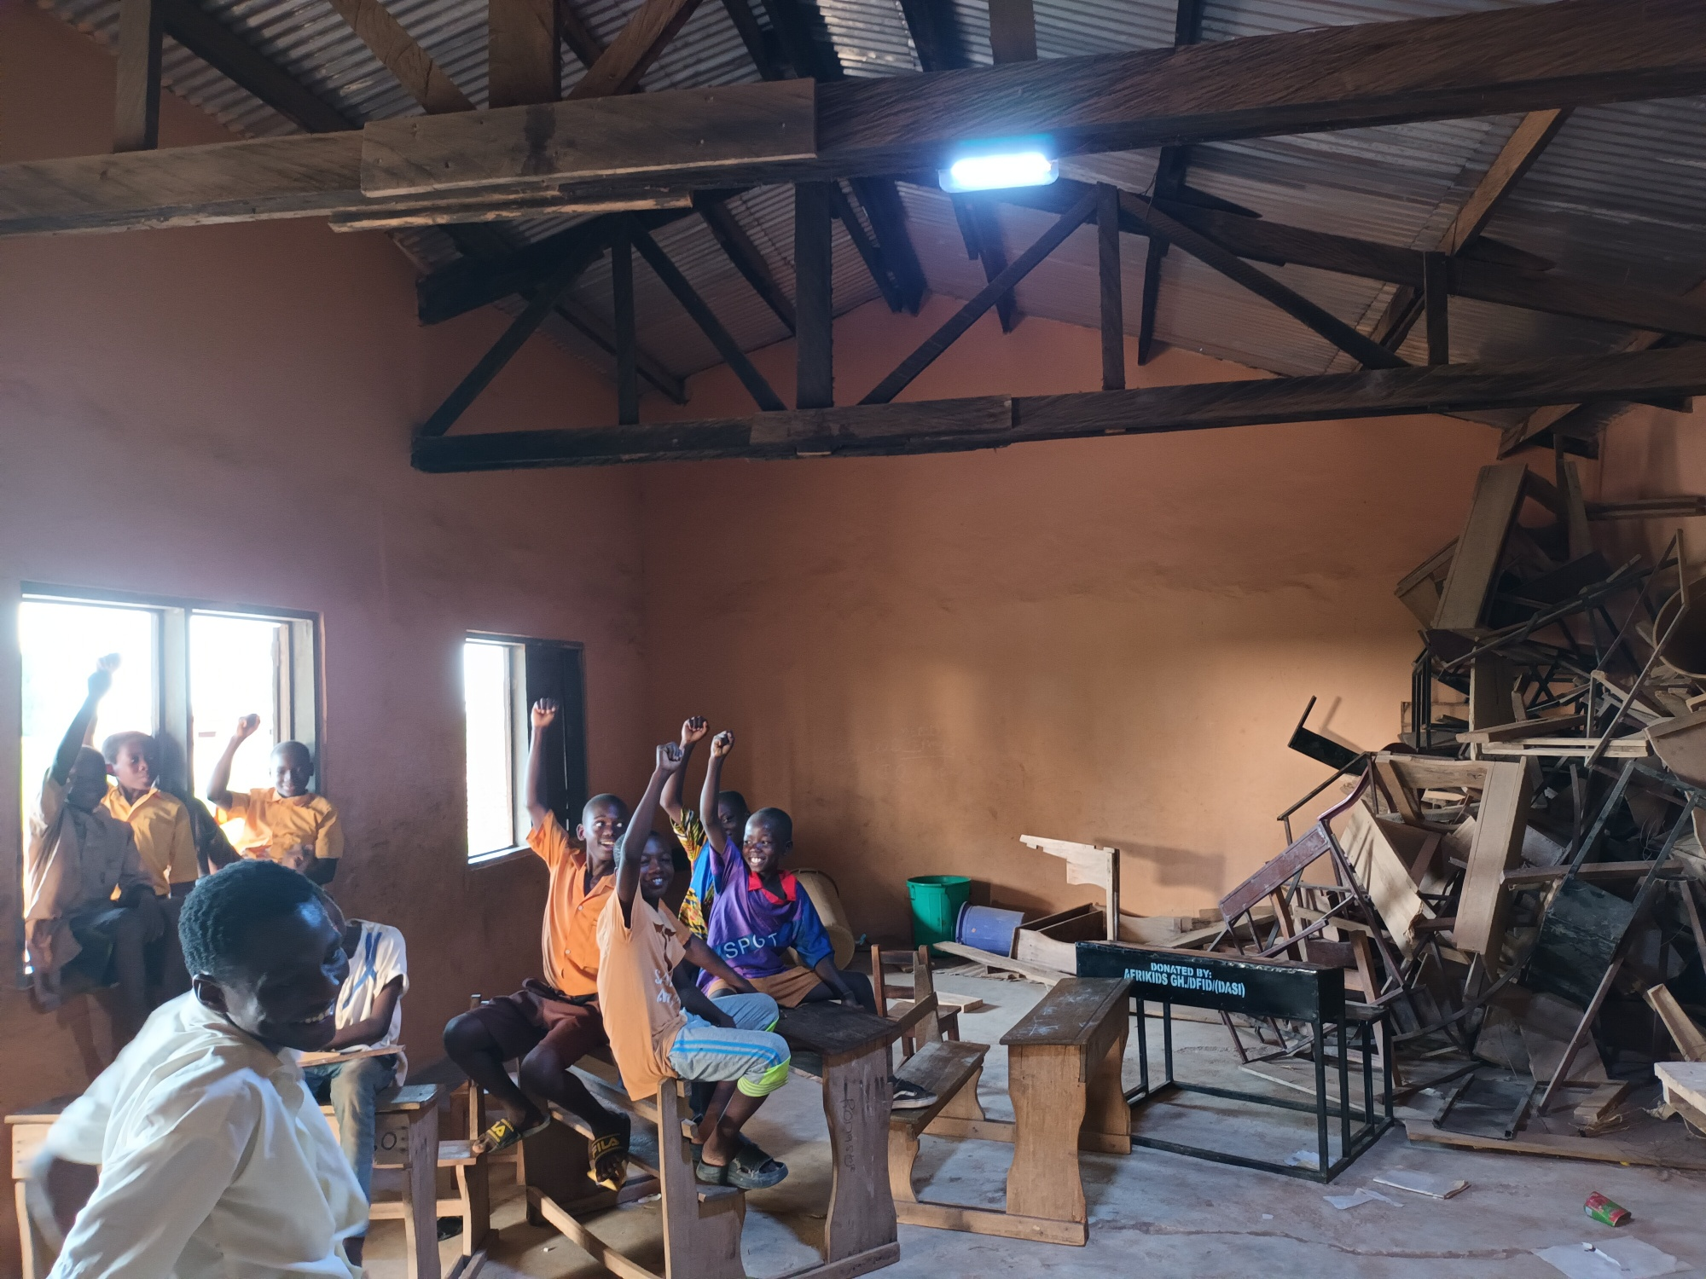
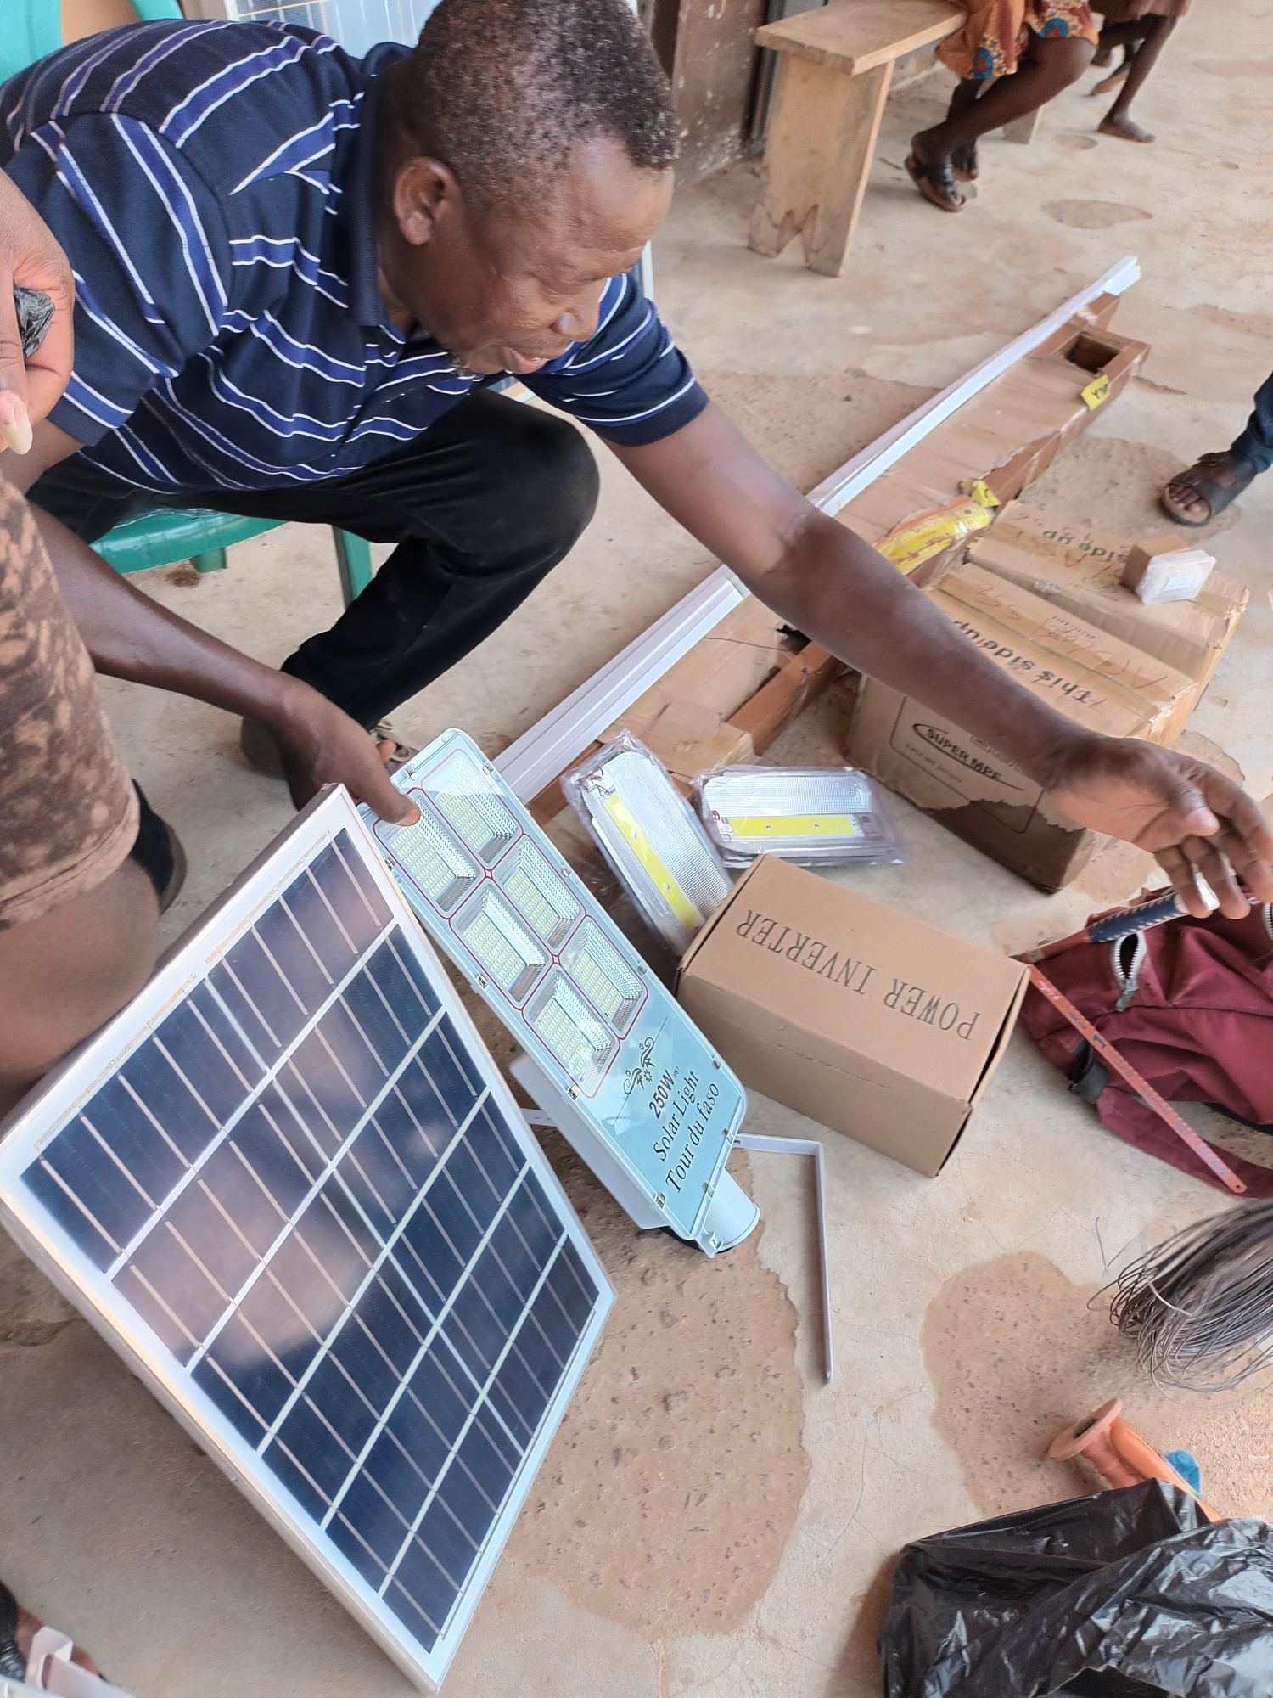
2023 Solceller barneskole

Slide 16
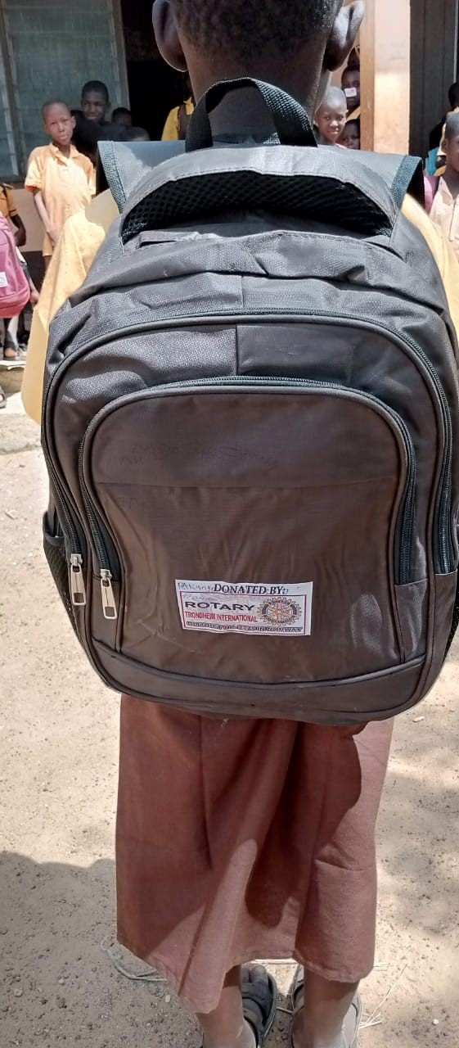
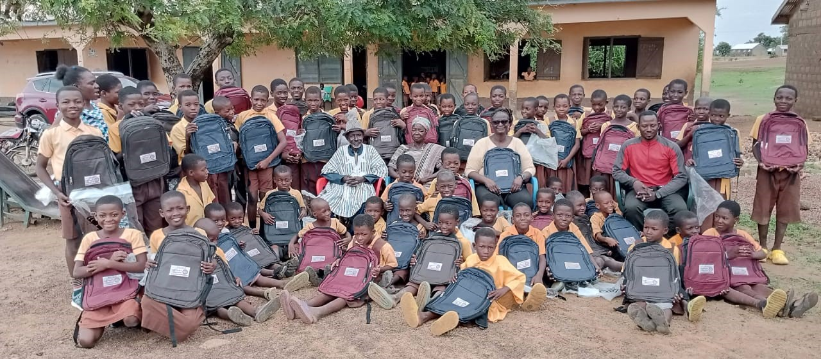
2024 Skolesekker

Slide 17
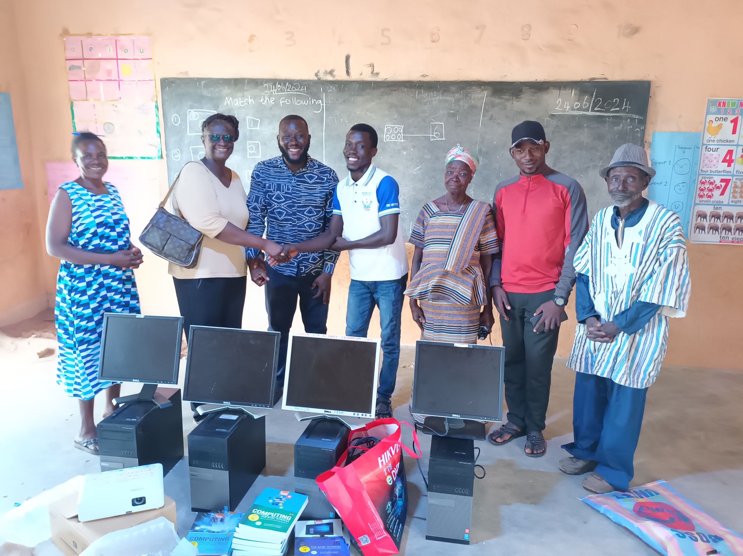
2025 Datautstyr/Lærebøker

Slide 18
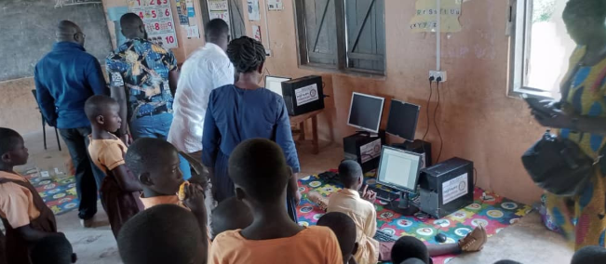
2025 Datautstyr/Lærebøker

Slide 19
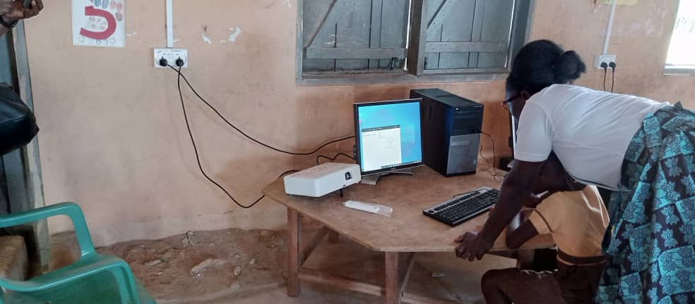
2025 Datautstyr/Lærebøker

